Slide 1
C Language Overview

Slide 2
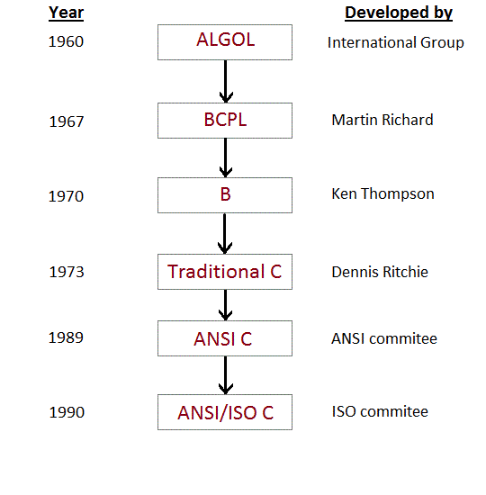
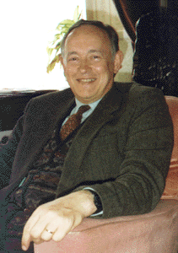
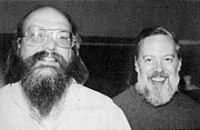

History of C language

Slide 3
Notes:
C is a structured programming language developed by Dennis Ritchie in 1973 at Bell Laboratories.

